Slide 1
PyInstrument
Tool for instrument automation

Slide 2
Requirement
python 3.6 +
pip
pyvisa

Slide 3
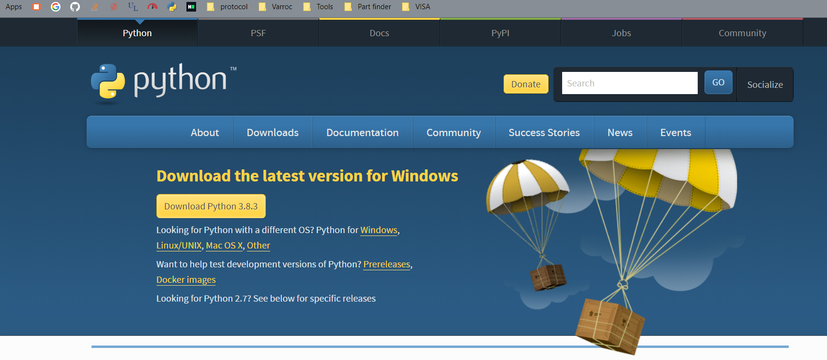
Python installation
Download the latest python setup from the hear

Slide 4
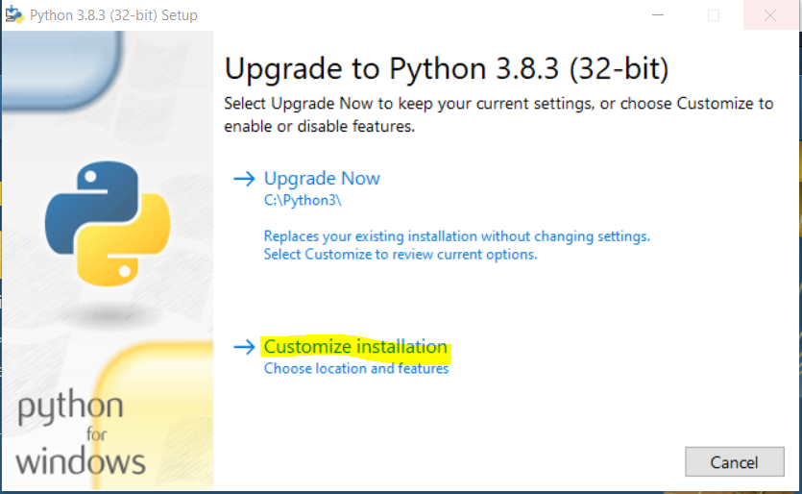
Python installation Cont.
Open the setup click on customize installation option

Slide 5
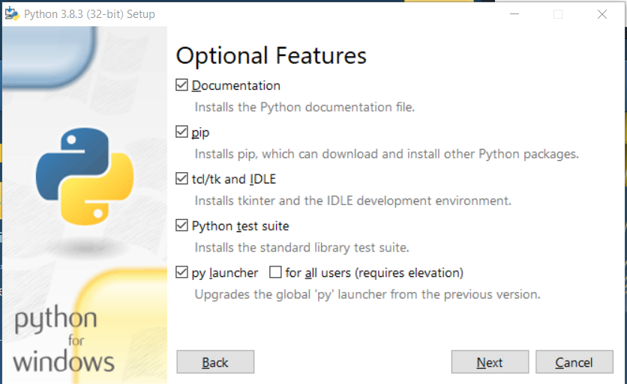
Select the option as shown in following image. Then hit next

Slide 6
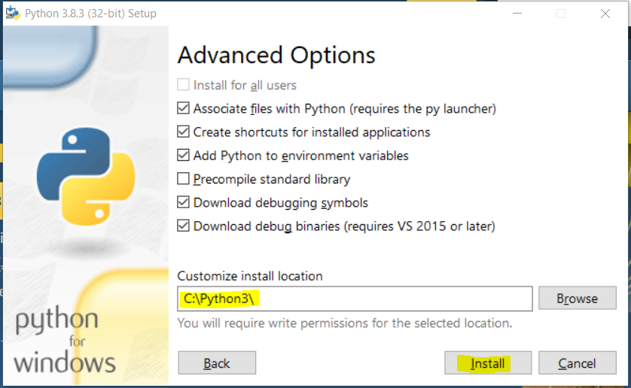
Add the path C:\Python3\ and hit install

Slide 7
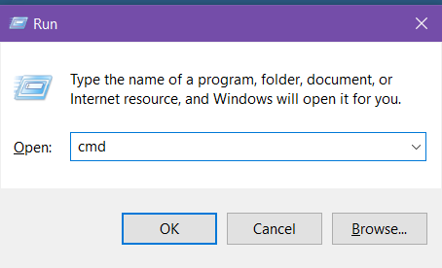
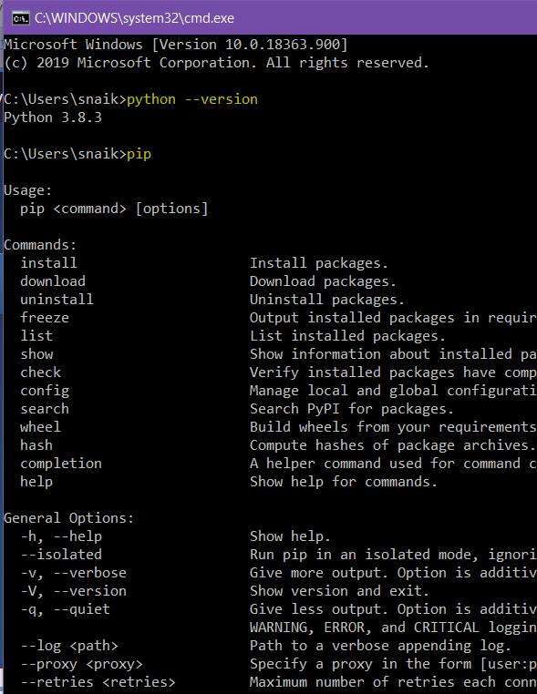
Check all component are install properly ☺
Press win Key + R
Type cmd
Type python --version
type pip

Slide 8
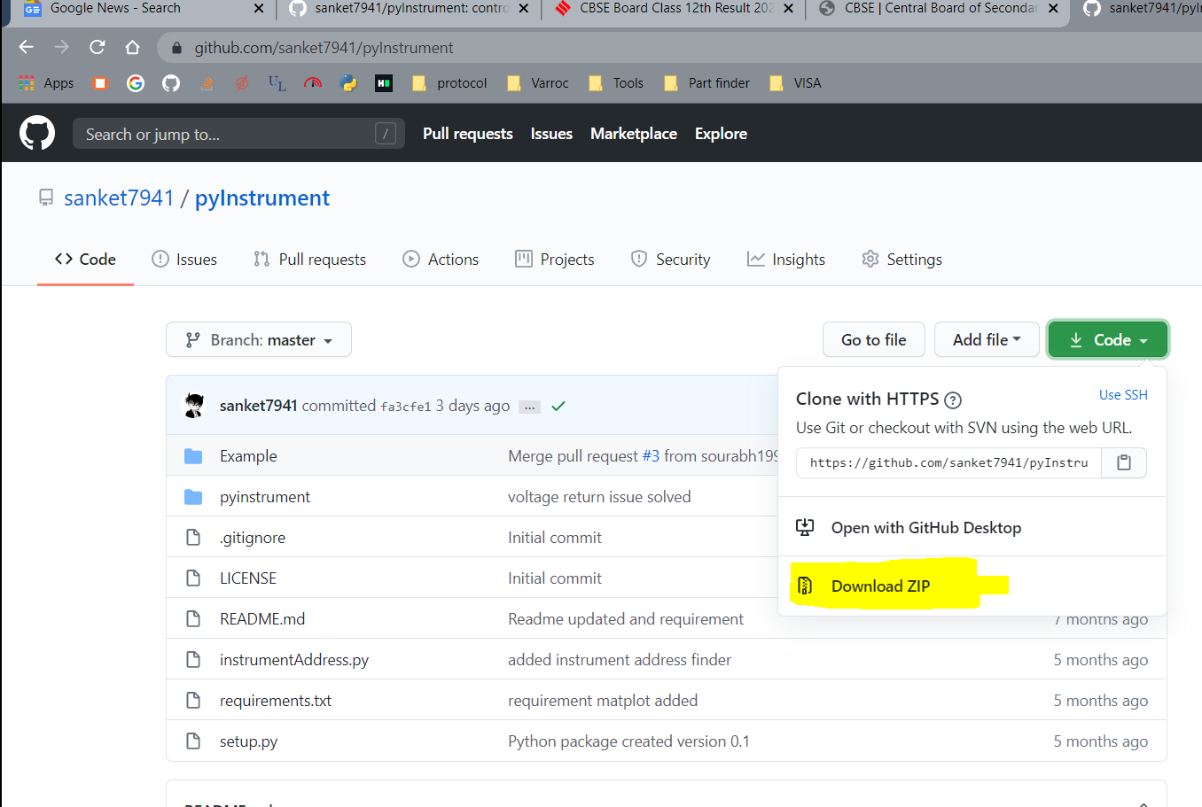
Installing PyInstrument
Download the setup from here

Slide 9
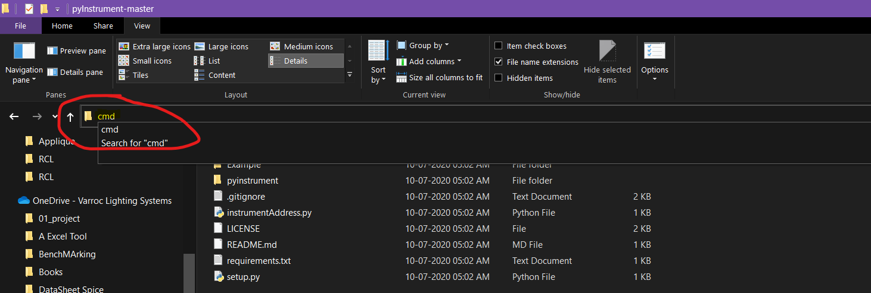
Extract the pyInstrument folder. And in path window again type cmd.
hit enter

Slide 10
use following command to install all packages’
“pip install -r requirements.txt”
“Pip install .”

Slide 11


